Slide 1
SQL Bootcamp
Noble Desktop

Slide 2

Subqueries
Inner query evaluated first
Substitutes in one or multiple values

Slide 3
Single Value subquery
select * from purchase_items where price =
(select max(price) from products)

Slide 4

Primary key
Column that is unique per row
Never changes, like a Social Security Number

Slide 5
Foreign key
Reference to primary key in different table
Like a “link” to that row

Slide 6
inner Join
If any primary/foreign key is missing, row is ignored
Results may be smaller than either table being joined

Slide 7
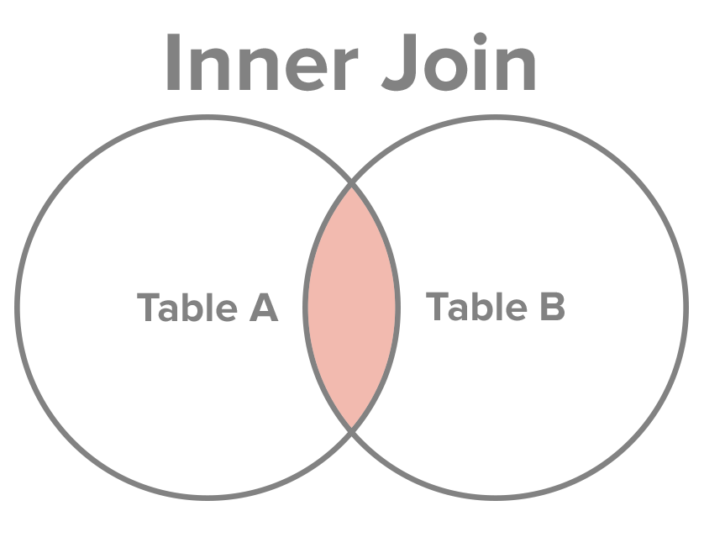

Slide 8
Inner Join
SELECT name, email FROM purchases INNER JOIN users on purchases.user_id = users.id

Slide 9
Conditional
select title,
case when (price < 100)
then 'cheap'
else 'expensive'
end from products;

Slide 10
Exercises

Slide 11

Modifying Data

Slide 12
INsert
One row at a time, typically
Additive
Safer than other actions

Slide 13
InSert
INSERT INTO products VALUES
(1,'iPod',79,NOW(),null,'{Book}')

Slide 14
InSert
INSERT INTO products
(id,title,price,created_at,tags)
(1,'iPod',79,NOW(),'{Book}')

Slide 15
Update
Targets rows in WHERE clause
No WHERE means entire table
VERY DANGER

Slide 16
UPDATE
UPDATE products
SET title = 'New Book'
WHERE title = 'Fiction Book';

Slide 17
UPDATE
UPDATE products
SET title = 'New Book’;

Slide 18

UPDATE
UPDATE products
SET title = 'New Book’;
OH NO! EVERY BOOK IS CHANGED!

Slide 19
Transactions
Apply changes as a bundle
Preview changes before they are committed

Slide 20
Transactions
BEGIN;
...
COMMIT;

Slide 21
Transactions
BEGIN;
...
ROLLBACK;

Slide 22
Transactions
BEGIN;
...
—-ROLLBACK;

Slide 23
Exercises

Slide 24

Exports and backups

Slide 25
CSV

Slide 26
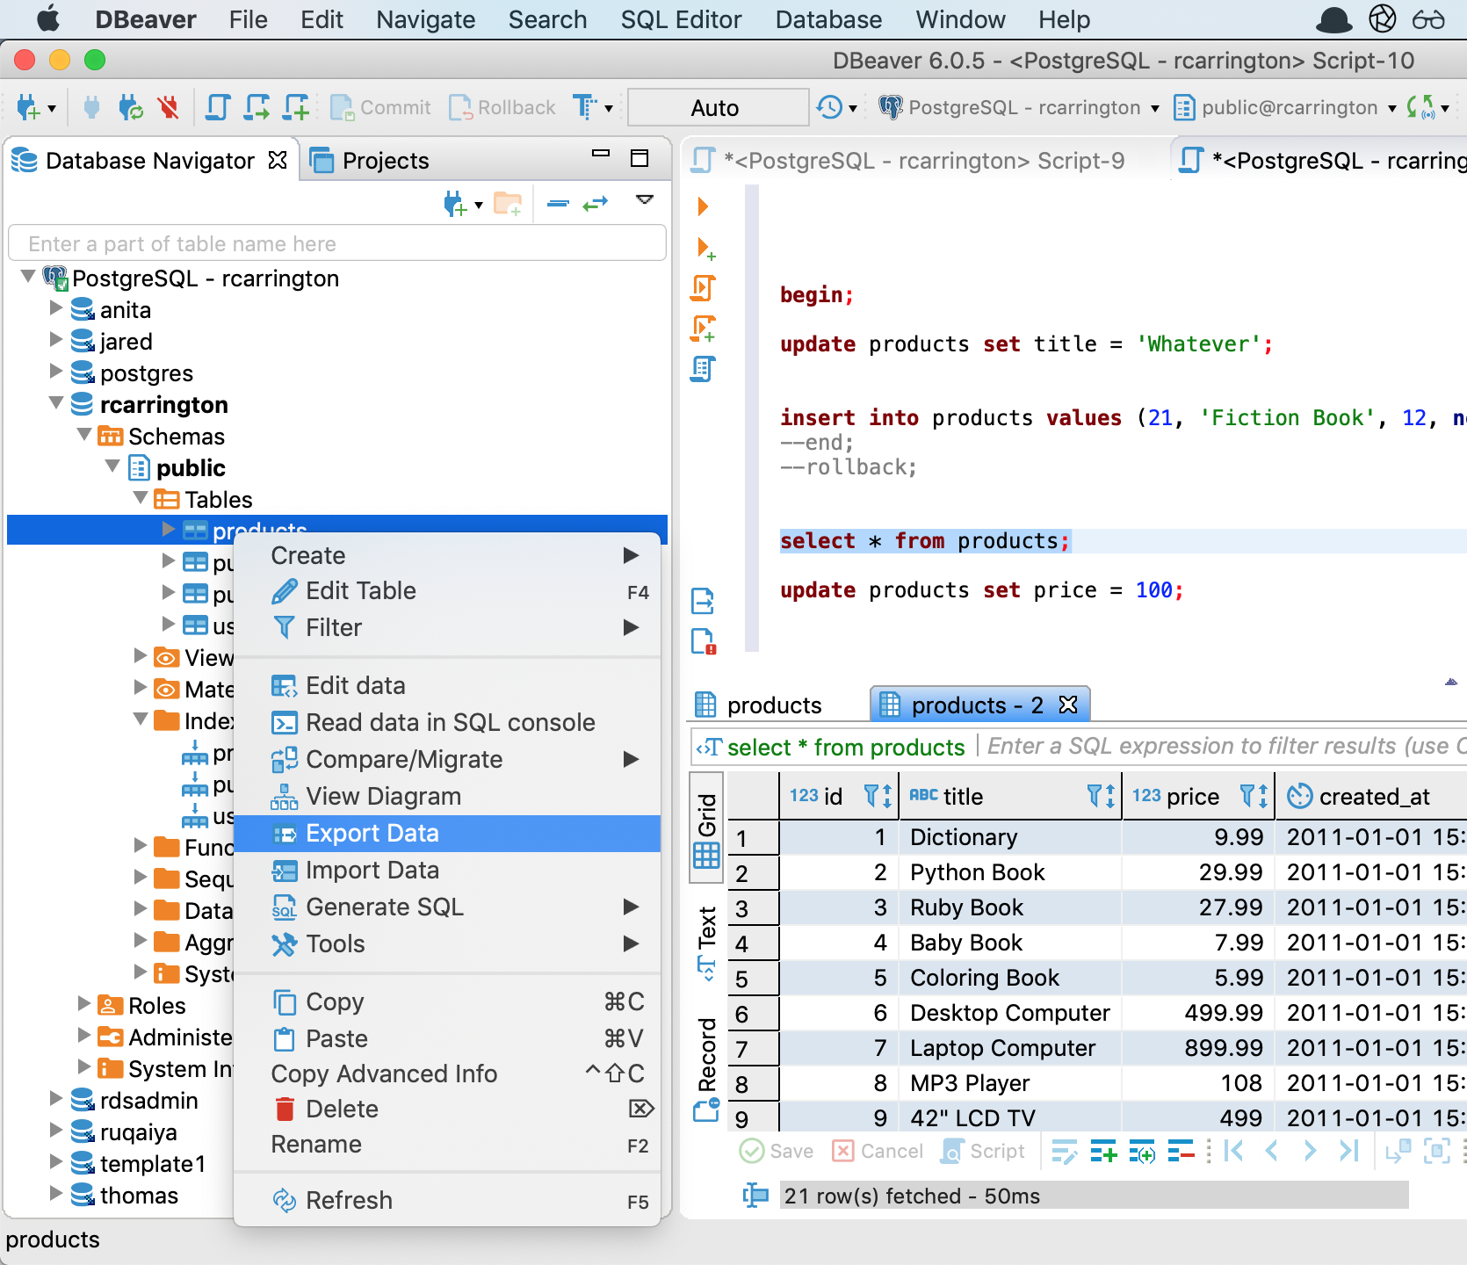
Text

Slide 27
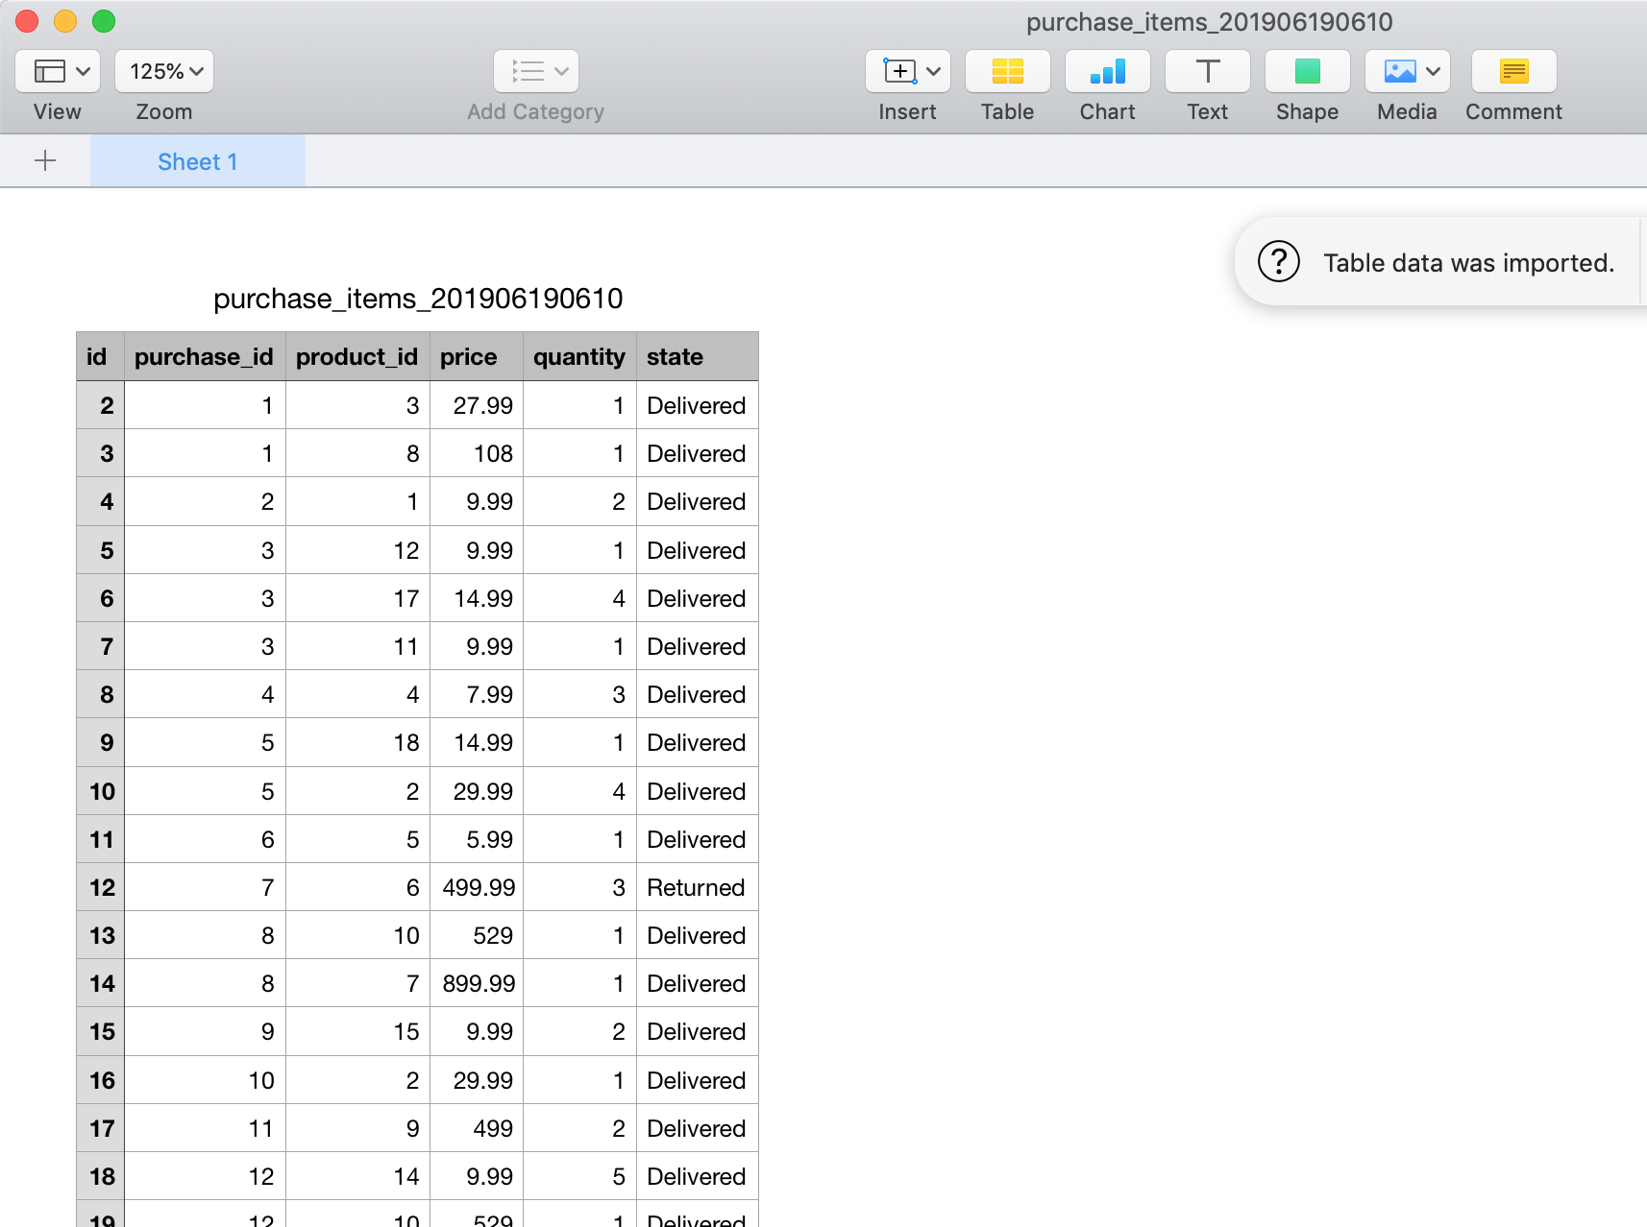
Text

Slide 28
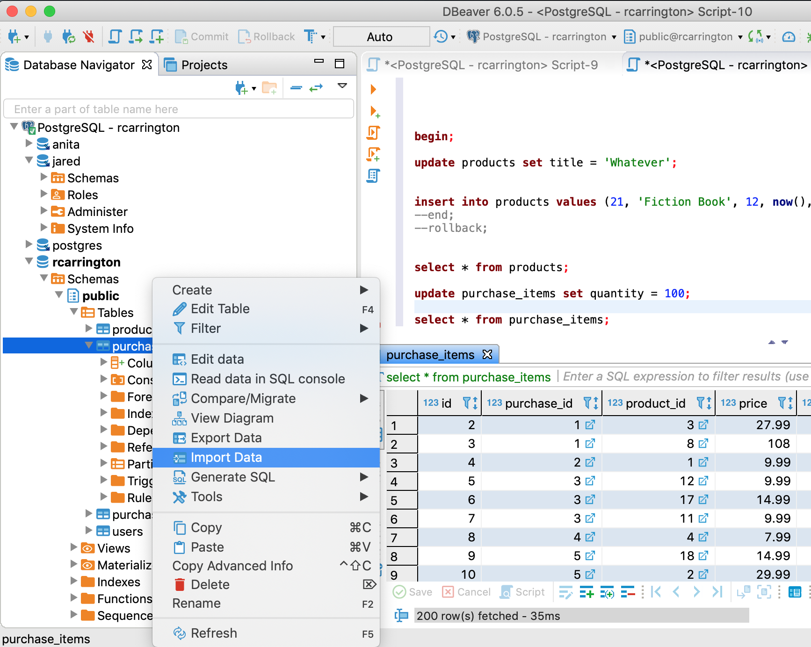
Text

Slide 29
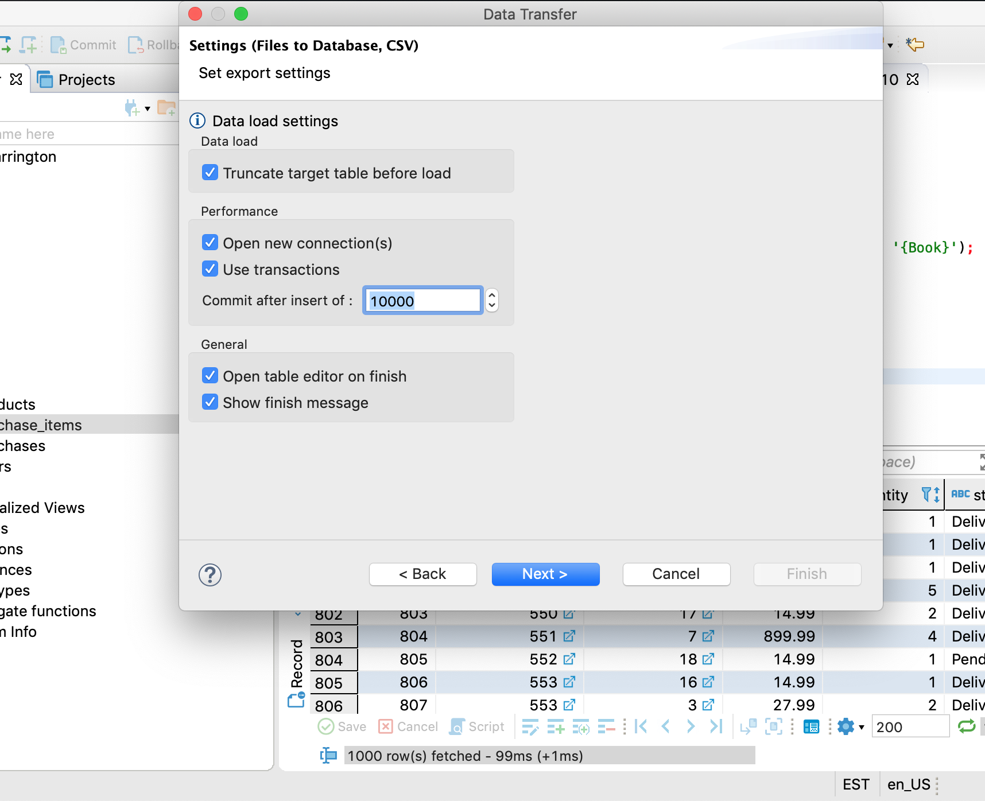
Text

Slide 30
Backups

Slide 31
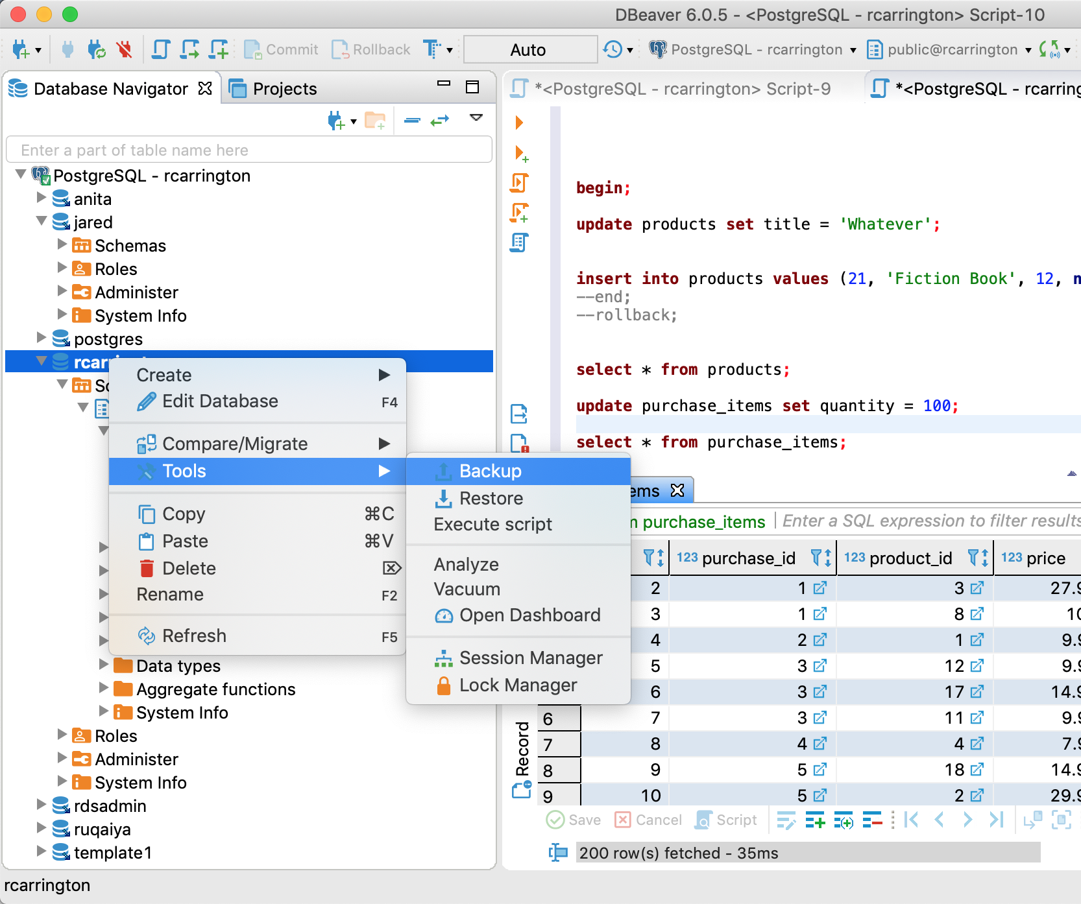
Text

Slide 32
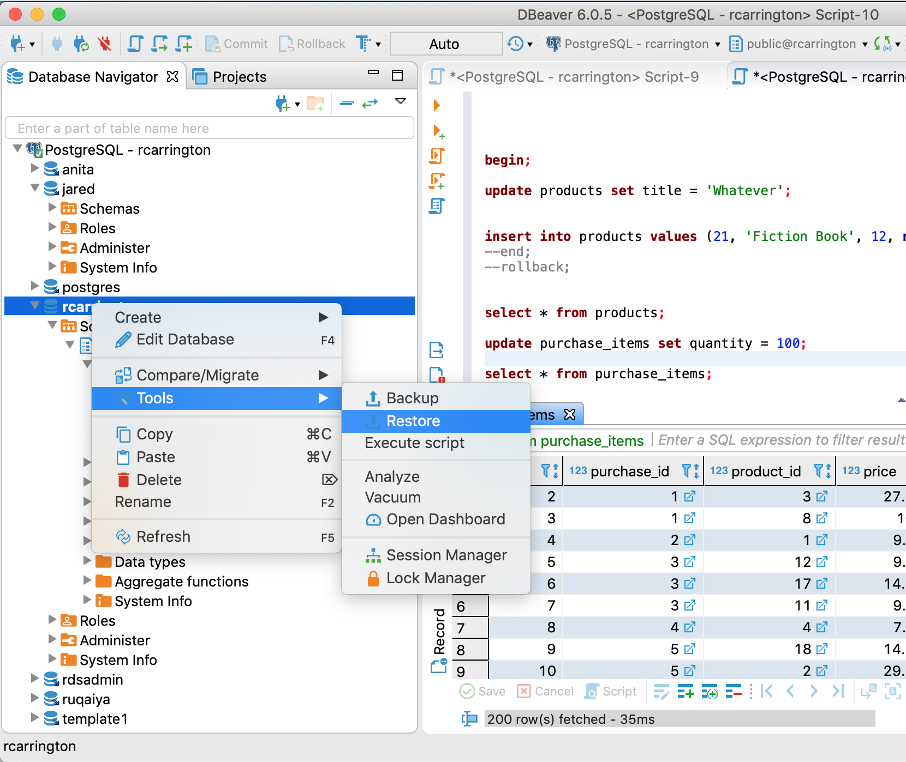
Text

Slide 33
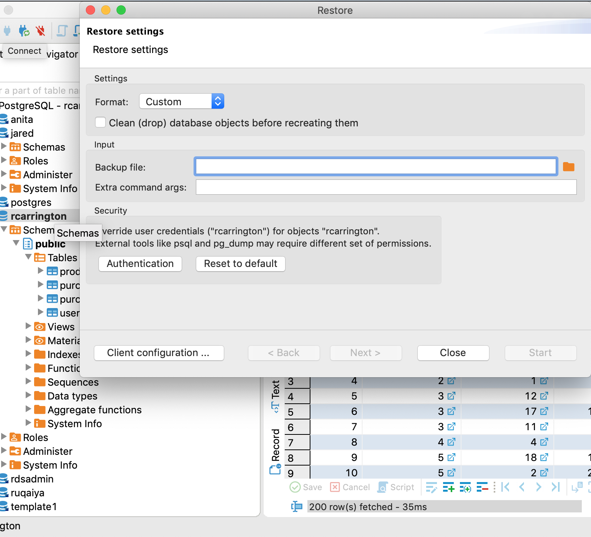
Text

Slide 34
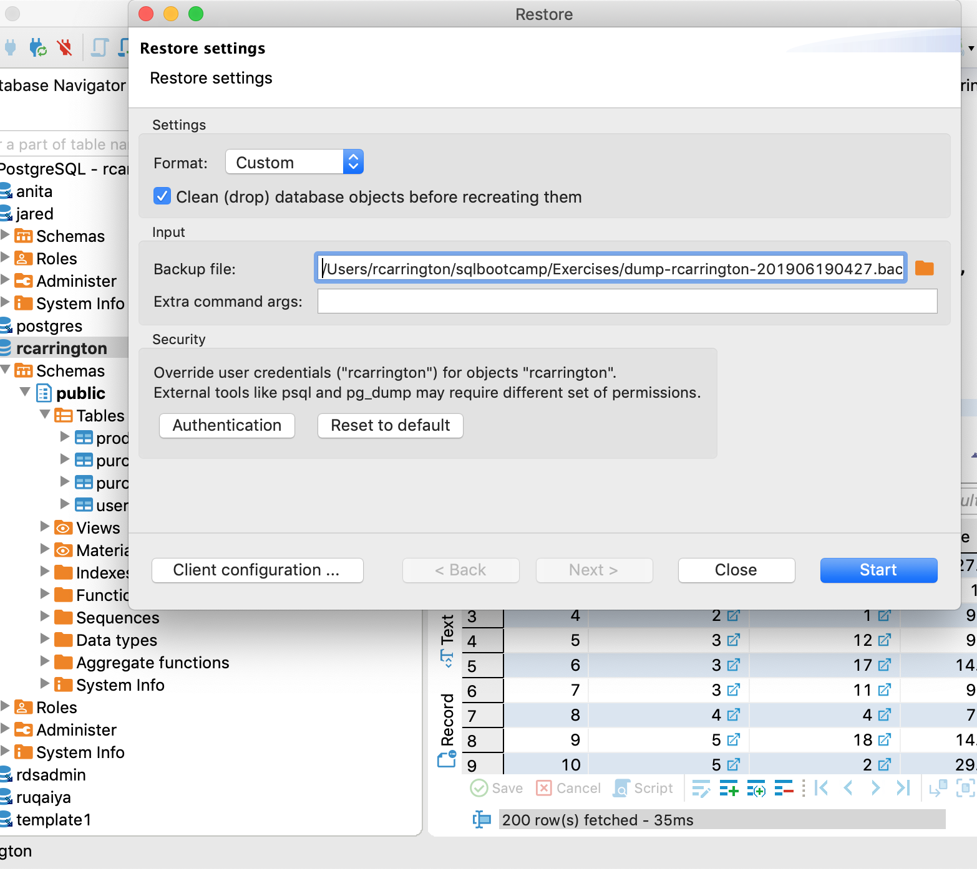
Text

